Slide 1
Random Forest
Predrag Radenković 3237/10
Faculty of Electrical Engineering
University Of Belgrade

Slide 2
Definition
Random forest (or random forests) is an ensemble classifier that consists of many decision trees and outputs the class that is the mode of the class's output by individual trees.
The term came from random decision forests that was first proposed by Tin Kam Ho of Bell Labs in 1995.
The method combines Breiman's "bagging" idea and the random selection of features.

Slide 3
Decision trees
Decision trees are individual learners that are combined. They are one of the most popular learning methods commonly used for data exploration.
One type of decision tree is called CART… classification and regression tree.
CART … greedy, top-down binary, recursive partitioning, that divides feature space into sets of disjoint rectangular regions.
Regions should be pure wrt response variable
Simple model is fit in each region – majority vote for classification, constant value for regression.

Slide 4
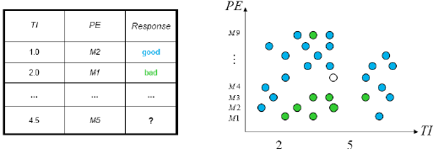
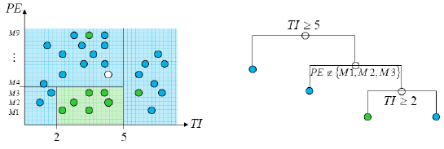
Decision tress involve greedy, recursive partitioning.
Simple dataset with two predictors
Greedy, recursive partitioning along TI and PE

Slide 5
Algorithm
Each tree is constructed using the following algorithm:
Let the number of training cases be N, and the number of variables in the classifier be M.
We are told the number m of input variables to be used to determine the decision at a node of the tree; m should be much less than M.
Choose a training set for this tree by choosing n times with replacement from all N available training cases (i.e. take a bootstrap sample). Use the rest of the cases to estimate the error of the tree, by predicting their classes.
For each node of the tree, randomly choose m variables on which to base the decision at that node. Calculate the best split based on these m variables in the training set.
Each tree is fully grown and not pruned (as may be done in constructing a normal tree classifier).
For prediction a new sample is pushed down the tree. It is assigned the label of the training sample in the terminal node it ends up in. This procedure is iterated over all trees in the ensemble, and the average vote of all trees is reported as random forest prediction.

Slide 6
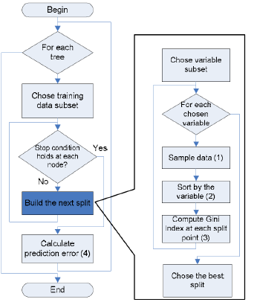
Algorithm flow chart
For computer scientists:

Slide 7
Random Forest – practical consideration
Splits are chosen according to a purity measure:
E.g. squared error (regression), Gini index or devinace (classification)
How to select N?
Build trees until the error no longer decreases
How to select M?
Try to recommend defaults, half of them and twice of them and pick the best.

Slide 8
Features and Advantages
The advantages of random forest are:
It is one of the most accurate learning algorithms available. For many data sets, it produces a highly accurate classifier.
It runs efficiently on large databases.
It can handle thousands of input variables without variable deletion.
It gives estimates of what variables are important in the classification.
It generates an internal unbiased estimate of the generalization error as the forest building progresses.
It has an effective method for estimating missing data and maintains accuracy when a large proportion of the data are missing.

Slide 9
Features and Advantages
It has methods for balancing error in class population unbalanced data sets.
Generated forests can be saved for future use on other data.
Prototypes are computed that give information about the relation between the variables and the classification.
It computes proximities between pairs of cases that can be used in clustering, locating outliers, or (by scaling) give interesting views of the data.
The capabilities of the above can be extended to unlabeled data, leading to unsupervised clustering, data views and outlier detection.
It offers an experimental method for detecting variable interactions.

Slide 10
Disadvantages
Random forests have been observed to overfit for some datasets with noisy classification/regression tasks.
For data including categorical variables with different number of levels, random forests are biased in favor of those attributes with more levels. Therefore, the variable importance scores from random forest are not reliable for this type of data.

Slide 11
RM - Additional information
Estimating the test error:
While growing forest, estimate test error from training samples
For each tree grown, 33-36% of samples are not selected in bootstrap, called out of bootstrap (OOB) samples
Using OOB samples as input to the corresponding tree, predictions are made as if they were novel test samples
Through book-keeping, majority vote (classification), average (regression) is computed for all OOB samples from all trees.
Such estimated test error is very accurate in practice, with reasonable N

Slide 12
RM - Additional information
Estimating the importance of each predictor:
Denote by ê the OOB estimate of the loss when using original training set, D.
For each predictor xp where p∈{1,..,k}
Randomly permute pth predictor to generate a new set of samples D' ={(y1,x'1),…,(yN,x'N)}
Compute OOB estimate êk of prediction error with the new samples
A measure of importance of predictor xp is êk – ê, the increase in error due to random perturbation of pth predictor

Slide 13
Conclusions & summary:
Fast fast fast!
RF is fast to build. Even faster to predict!
Practically speaking, not requiring cross-validation alone for model selection significantly speeds training by 10x-100x or more.
Fully parallelizable … to go even faster!
Automatic predictor selection from large number of candidates
Resistance to over training
Ability to handle data without preprocessing
data does not need to be rescaled, transformed, or modified
resistant to outliers
automatic handling of missing values
Cluster identification can be used to generate tree-based clusters through sample proximity

Slide 14
Thank you!

